Slide 1
Photomicrographs of Plant foods
Carrot
Permission to reproduce original photomicrographs used to make this collection may be obtained from
Dr. David O. Norris at
david.norris@colorado.edu

Slide 2
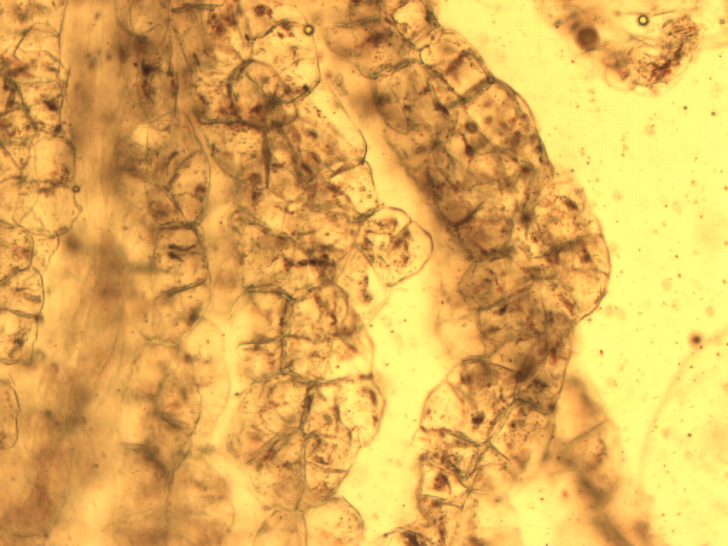
Notes:
117. Daucus L. (spp.) Carrot. Root cuboidal parenchymal cells, stained with safranin. 10X.

Slide 3
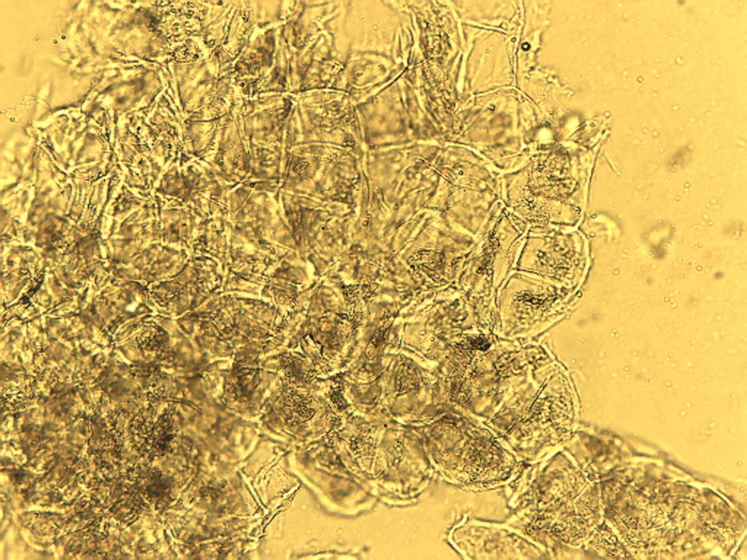
Notes:
118. Carrot. Root cuboidal cells, 10X.

Slide 4
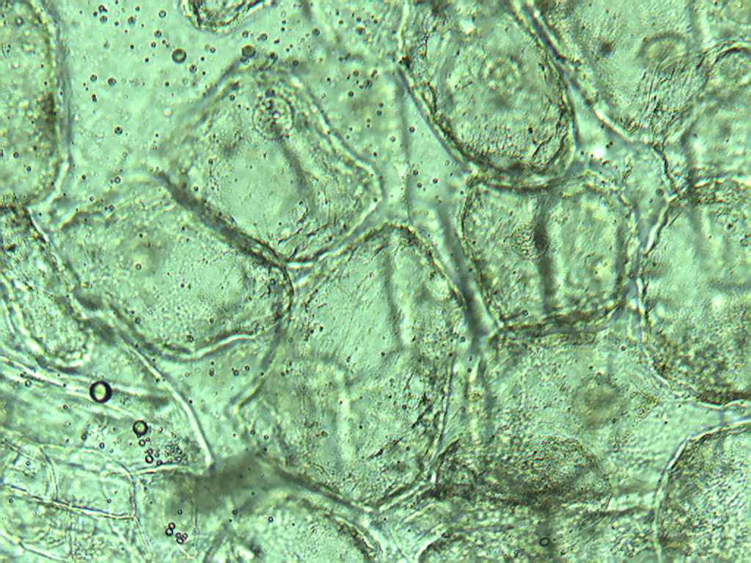
Notes:
119. Carrot. Root cuboidal cells, 25X.

Slide 5
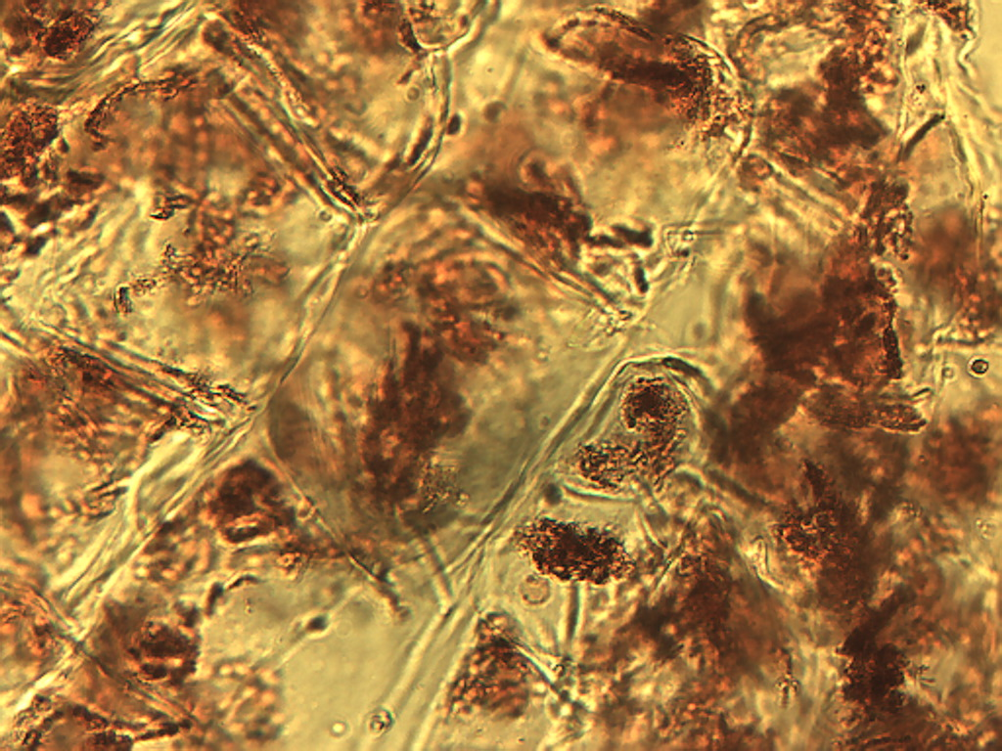
Notes:
120. Carrot, Root cuboidal cells stained with safranin, 25X

Slide 6
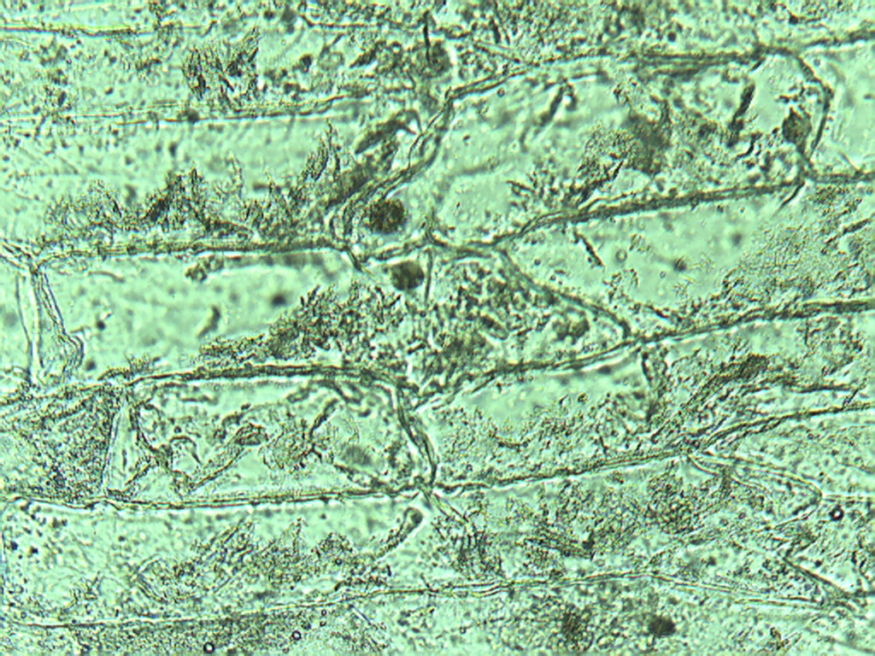
Notes:
121. Carrot. Root elongate “rectangular” cells 25X.

Slide 7
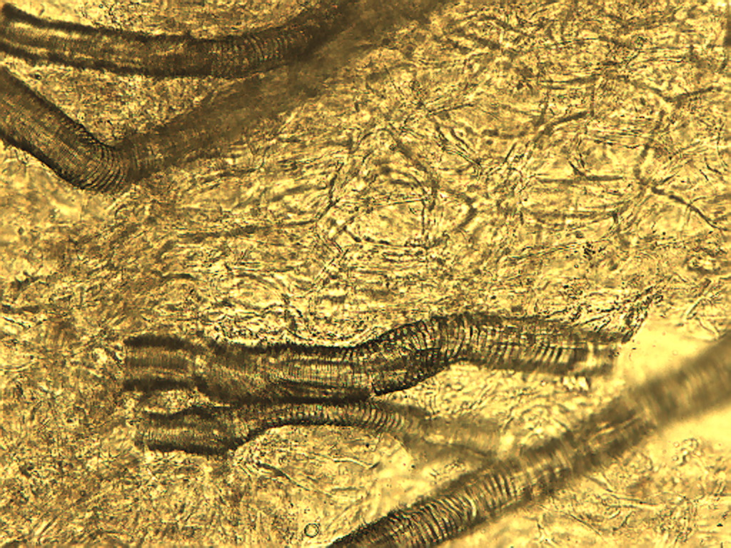
Notes:
122. Carrot. Root showing vascular elements (vessels) among parenchyma, 10X.

Slide 8
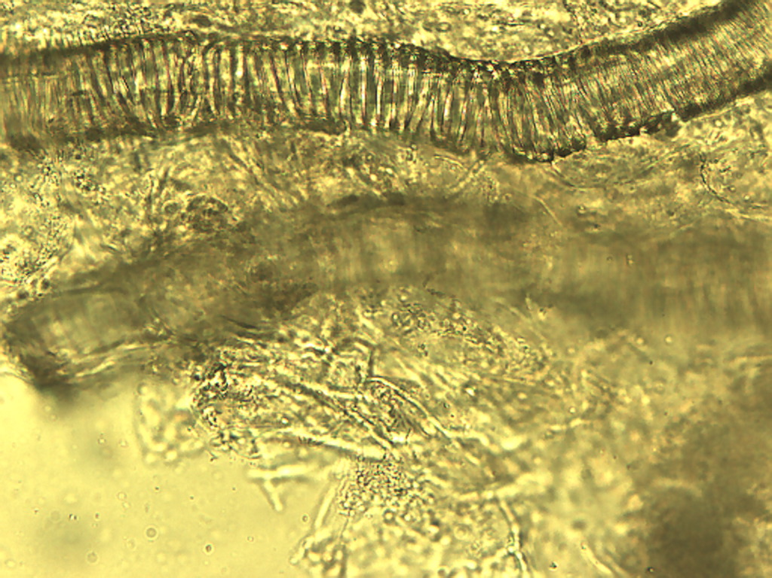
Notes:
123. Carrot. Root vessels, 25X.

